Slide 1


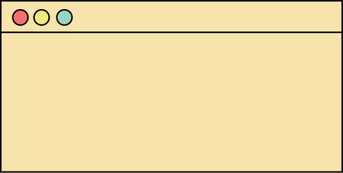
SELECTION
SORT
SORTING ALGORITHIM
GROUP 6
> Wayne Yzon D. Nagares
> Daryll Cris Celestial
> Sheree Ann Malapajo
> Aira Jeannelle Hepana
> Geilonn Salayo Romulo

Slide 2
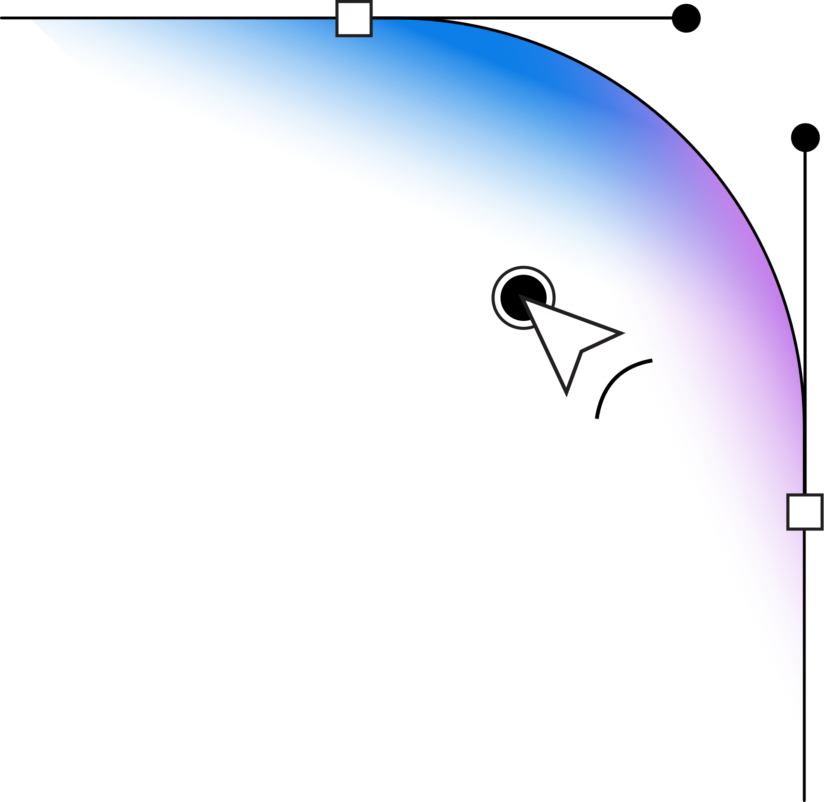

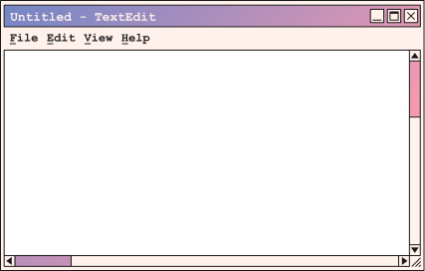
WHAT IS SELECTION SORT?
DEFENITION
Selection sort is a type of sorting algorithim, it uses comparison based sorting to sort the data (usually numbers or integers) and arrange them from smallest to largest.

Slide 3
WHAT IS SELECTION SORT?
ITS CASE USE
Selection sort is suitable for small datasets or applications where memory usage is a critical factor. It’s mostly used in an educational context as a way to introduce sorting algorithims to students, due to its straightforward concept and implementation

Slide 4


HOW SELECTION SORT WORKS
THE STEPS:
Scan through the list to find the smallest value and set it as the “first” of the row.
Compare the smallest value with the rest of the values and find the next smallest.
Swap the element in place with the next “smallest” value.
Keep repeating the process until all the values are sorted

Slide 5
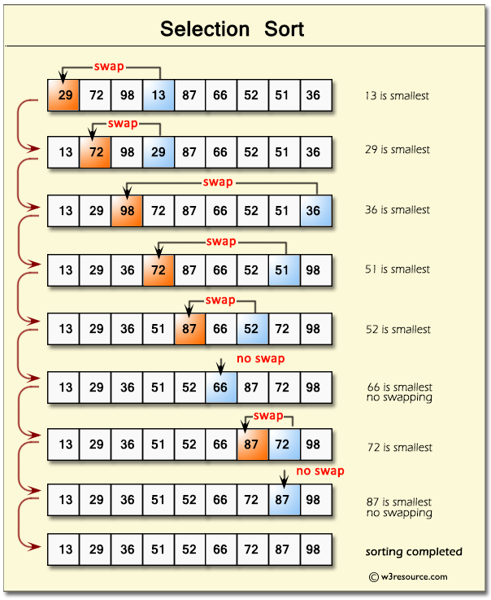
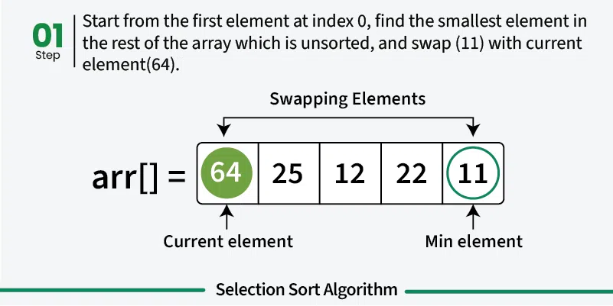
HOW SELECTION SORT WORKS
VISUAL DIAGRAM

Slide 6

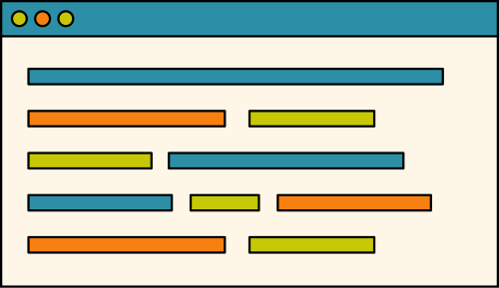
VISUAL PSEUDOCODE
PSEUDOCODE
FOR UNDERSTANDING THE PROCESS
Scan the array with values to sort (e.g., 64, 25, 12, 22, 11)
Scan the array and find the smallest value, after consider it as the current “minimum”.
Compare current "minimum" with every other element in the unsorted portion of the array.
Find smaller element, if smaller element is found, update the "minimum" to the new smaller element.
Swap the smallest element found with the first element of the unsorted portion.
Move to the next position and repeat the process until the entire array is sorted.
After every iteration, display the current state of the array to show the progress.
Display the fully sorted array.

Slide 7
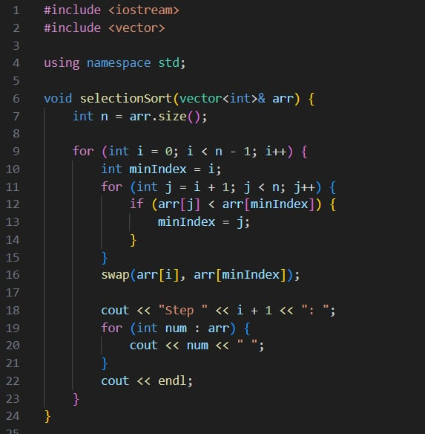

CODE PRESENTATION
C++ SELECTION SORT

Slide 8
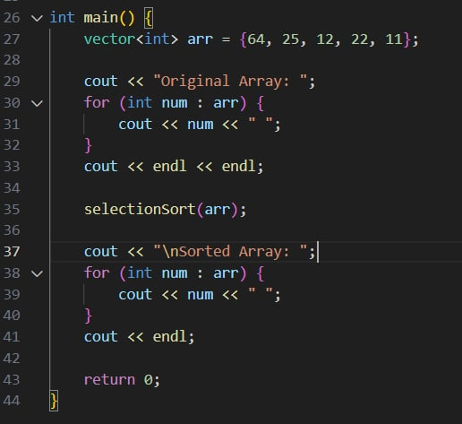
CODE PRESENTATION
C++ SELECTION SORT

Slide 9
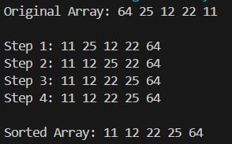
CODE PRESENTATION
C++ SELECTION SORT

